Slide 1
Game AI (Game Engines 2)
Dr Bryan Duggan
Dublin Institute of Technology

Slide 2
Prerequisites
Basic programming
Variables, conditions, loops, functions
OO Programming
Encapsulation, inheritance, polymorphism
Components
Game maths
Trigonometry, vectors, matrices, quaternions
Physics
Velocity, acceleration, forces

Slide 3
Course content
Steering behaviours
Seek, flee, pursue, evade, arrive, offset pursuit
Path following, wander
Obstacle avoidance
Flocking
Combining steering behaviours
Finite state machine AI, Goal directed AI, Behaviour trees
Path finding
Navigation graphs, A*

Slide 4
Code
BGE (C++)
https://github.com/skooter500/BGE
XNA (C#)
https://github.com/skooter500/XNA-3D-Steering-Behaviours-for-Space-Ships
Unity (C#, WIP)
https://github.com/skooter500/UnitySteeringBehaviours

Slide 5
Assignment
Recreate a classic space battle from your favourite Sci-fi movie!
Try and avoid Star Wars because it’s been done to death!
Pick classic Sci Fi...
Use any game engine you like (including BGE)
Check out:
http://www.youtube.com/watch?v=GdYAzGS0evA
http://www.youtube.com/watch?v=TkehS8EH2WQ
Consider...

Slide 6

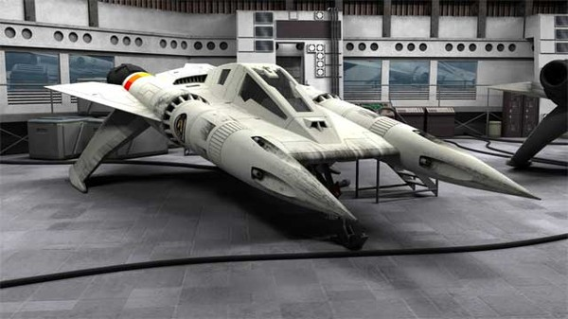

Slide 7
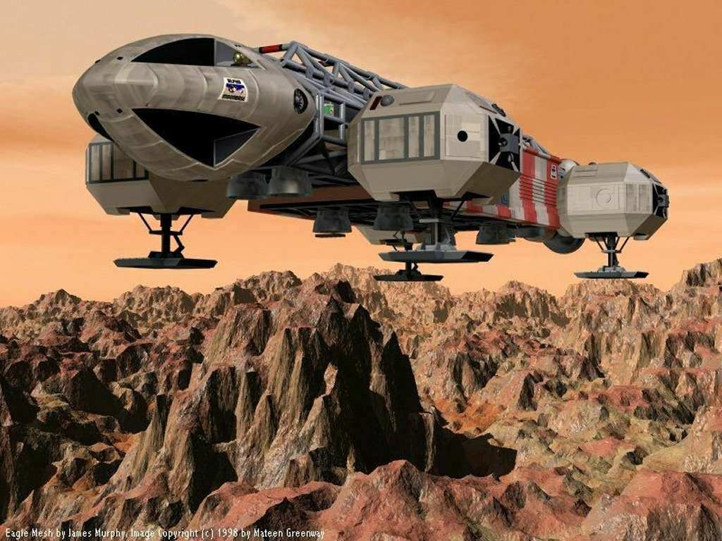

Slide 8
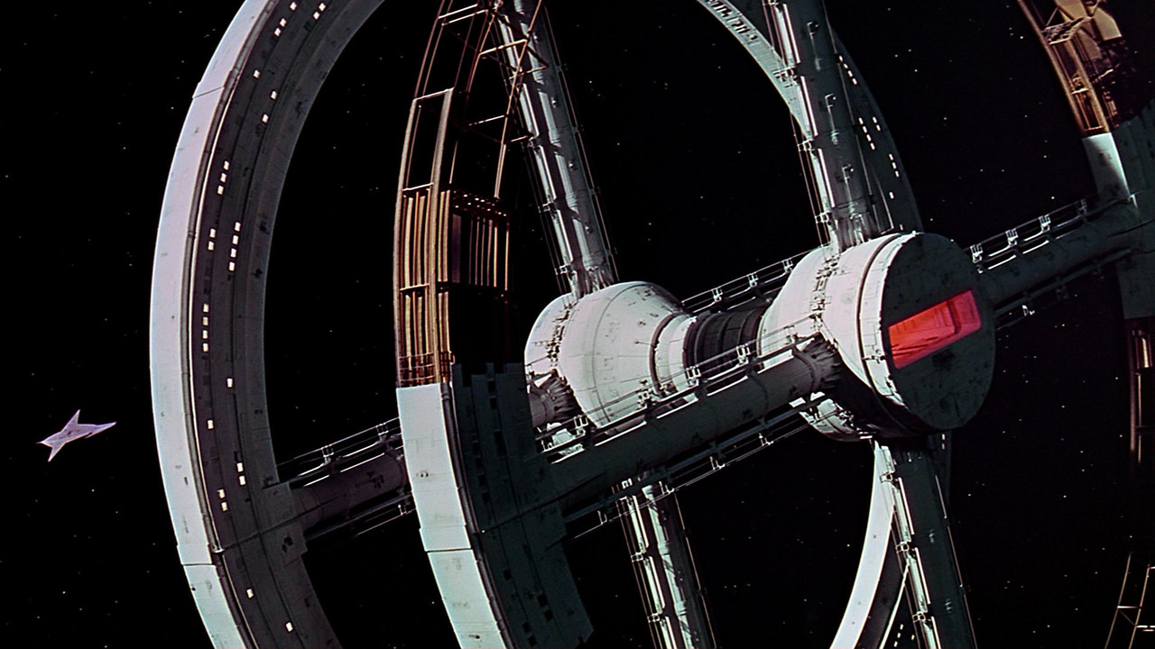

Slide 9
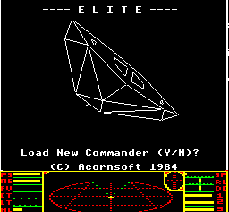
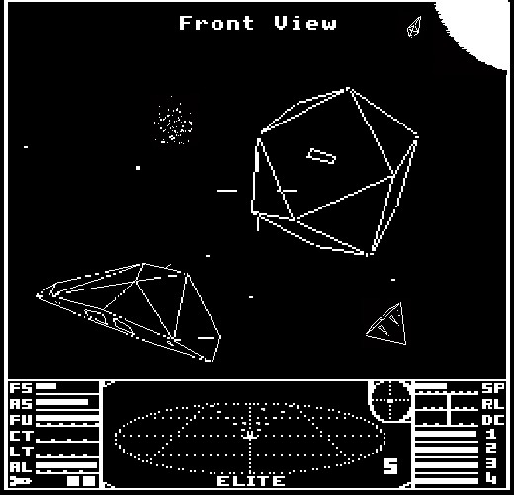

Slide 10
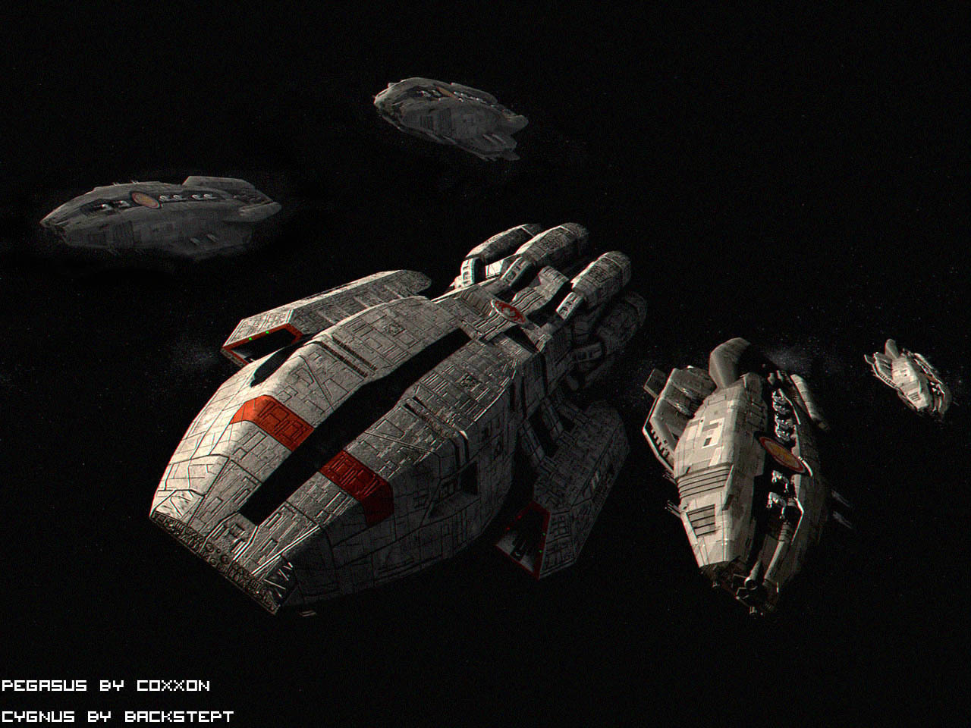

Slide 11
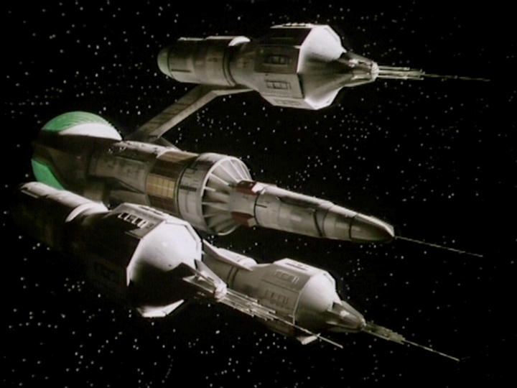

Slide 12



Slide 13
Deliverables!
17 Feb
Choose your space battle
Acquire your models
Imporred into Unity
Implement a path following steering behaviour
End of semester
Demo in class/YouTube video
Cosplay
Submit your github link only (must be the complete project so I can run it)
Through webcourses
Marking scheme
30% Complexity
30% Code quality
20% Story
20% Visuals

Slide 14
Software you will need
Unity or C++ (BGE)
http://unity3d.com/
The free version is fine unless you want to do Oculus Rift in which case you need Unity Pro
Visual Studio or MonoDevelop
MonoDevelop comes with Unity (I prefer VS personally)
Get Visual Studio through Dreamspark
Blender
Git for Windows (NOT the GitHub client)
http://msysgit.github.io/
http://gitcredentialstore.codeplex.com/ - Password cache

Slide 15
Game Maths
Trig
Vectors
For glm (BGE) Game Maths notes see
https://github.com/skooter500/BGE
...

Slide 16
Co-ordinate Geometry
Y-Axis
Point
X-Axis
The Z-Axis extends from the front of the screen (-) to behind the screen (+)
Unity is left handed co-ordinate system
Z-Axis

Slide 17
Points
Y-Axis
Point
X-Axis
Points are represented by 3 numbers (x, y, z).
x = offset from 0 (origin) on the x axis,
y = offset from 0 (origin) on the y axis,
z = offset from 0 (origin) on the z axis
Z-Axis

Slide 18
Pythagoras
H² = A² + O²
Sin θ = O / H
Cos θ = A / H
Tan θ = O/A
Sin ⁻¹ (O/H) = θ
Cos ⁻¹ (A/H) = θ
Tan ⁻¹ (O/A) = θ
H
O
θ
A

Slide 19
Angles
Keep in mind!
Where you are starting from (where is 0)
The direction (cw/ccw)
Most Unity functions expect and return RADIANS
See:
http://docs.unity3d.com/Documentation/ScriptReference/Mathf.html
Deg2Rad
Rad2Deg

Slide 20
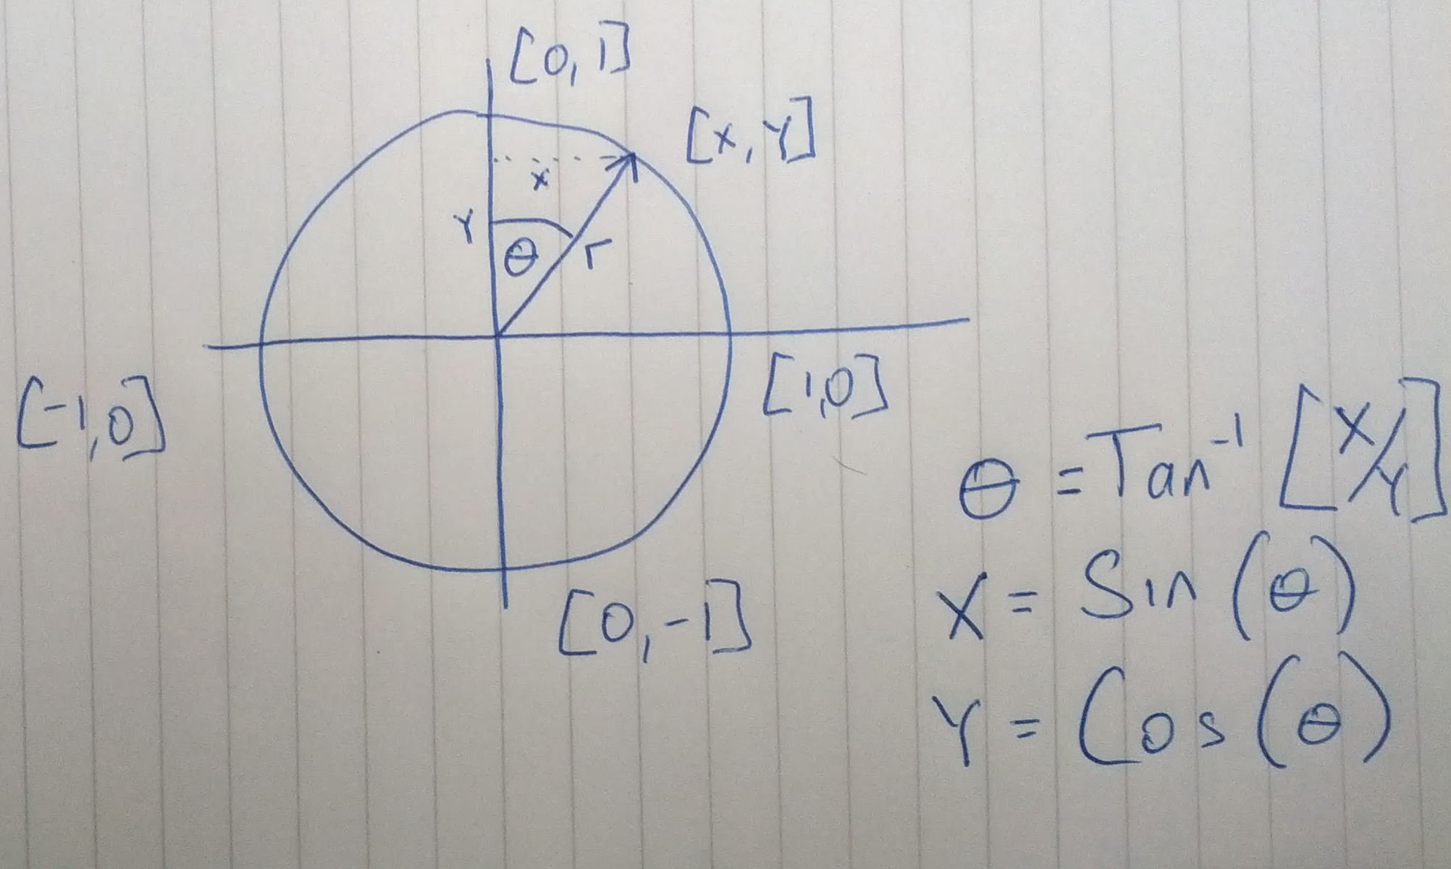

Slide 21
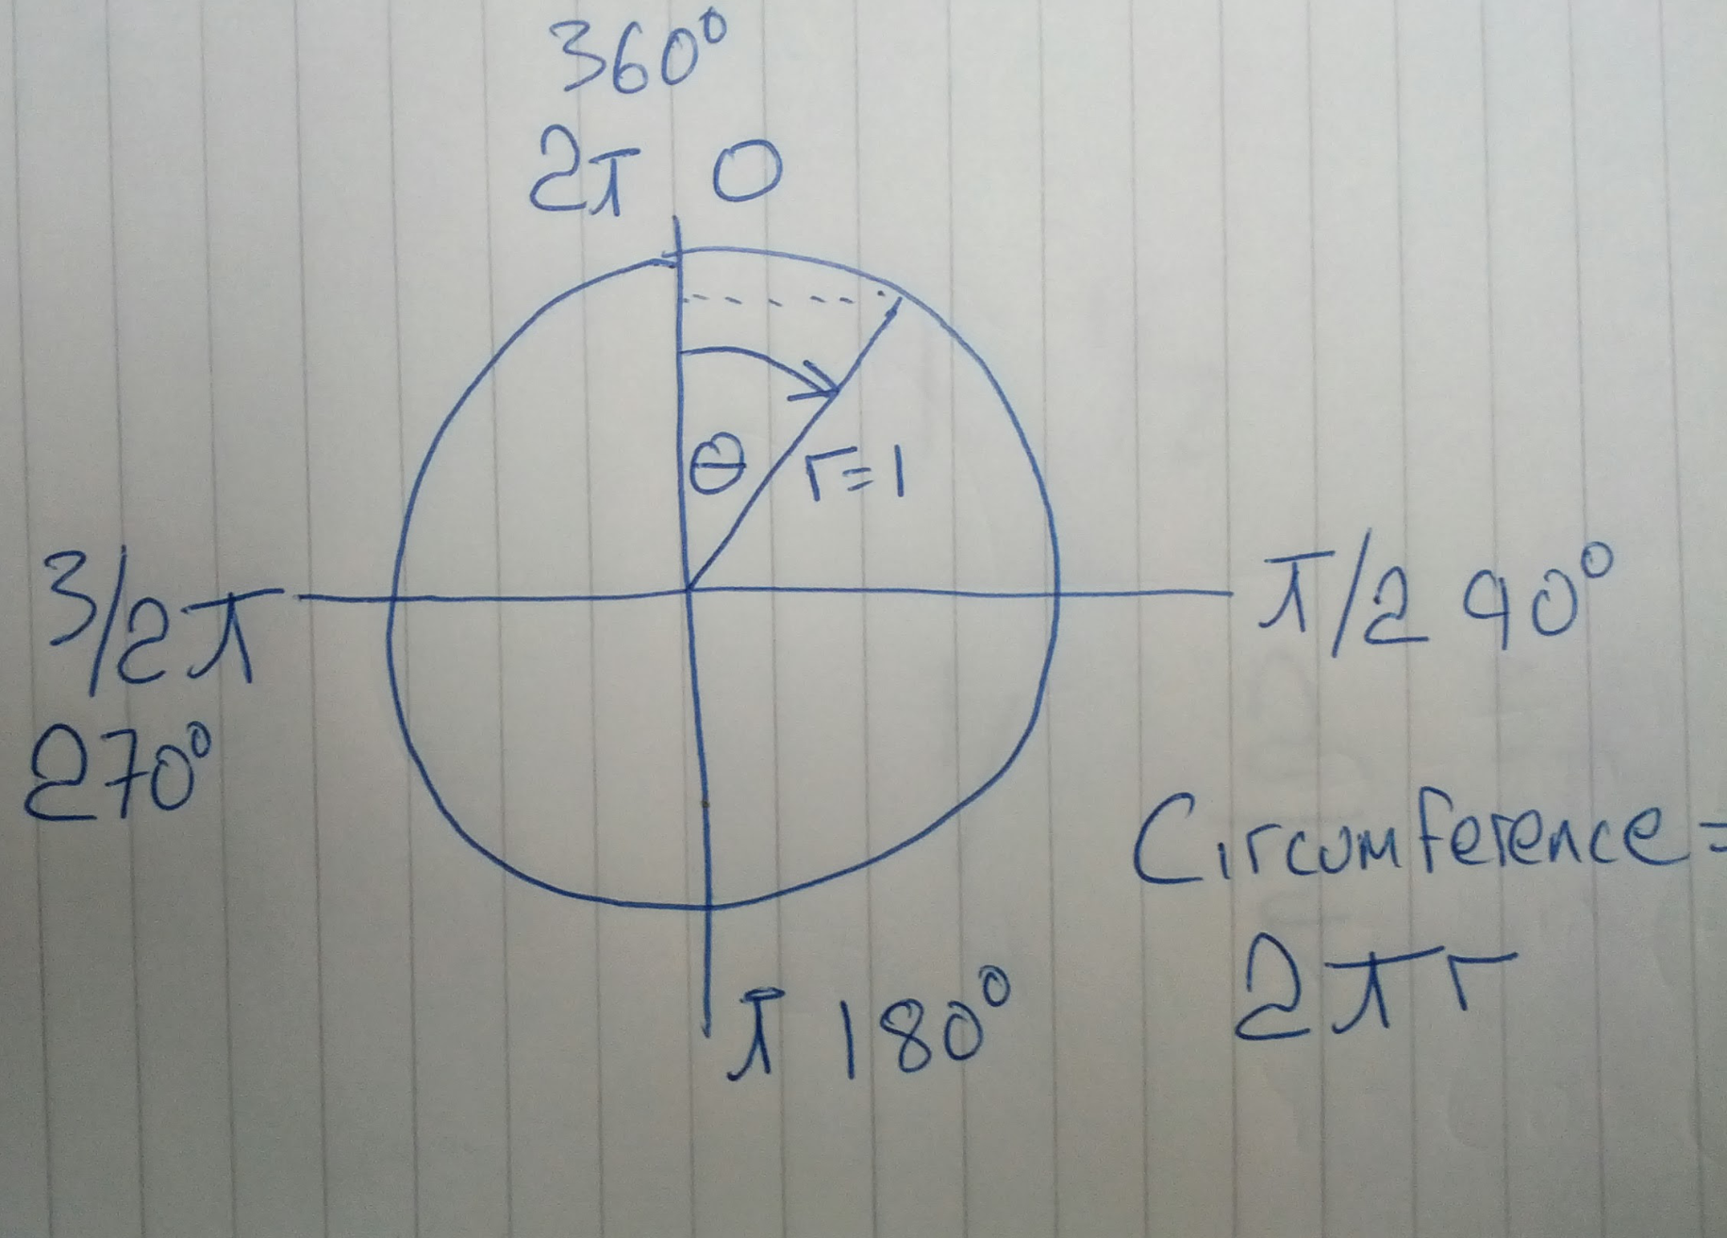

Slide 22
Unity Vectors
A scalar is just a single number (a float)
A vector is a list of numbers (Vector2/Vector3 structs)
We have to consider the direction of movement
2D directions are specified as offsets on the X and Y of position
3D directions are specified as offset on the X, and Y of position
The magnitude of the offset is the total distance moved...
Consider...

Slide 23
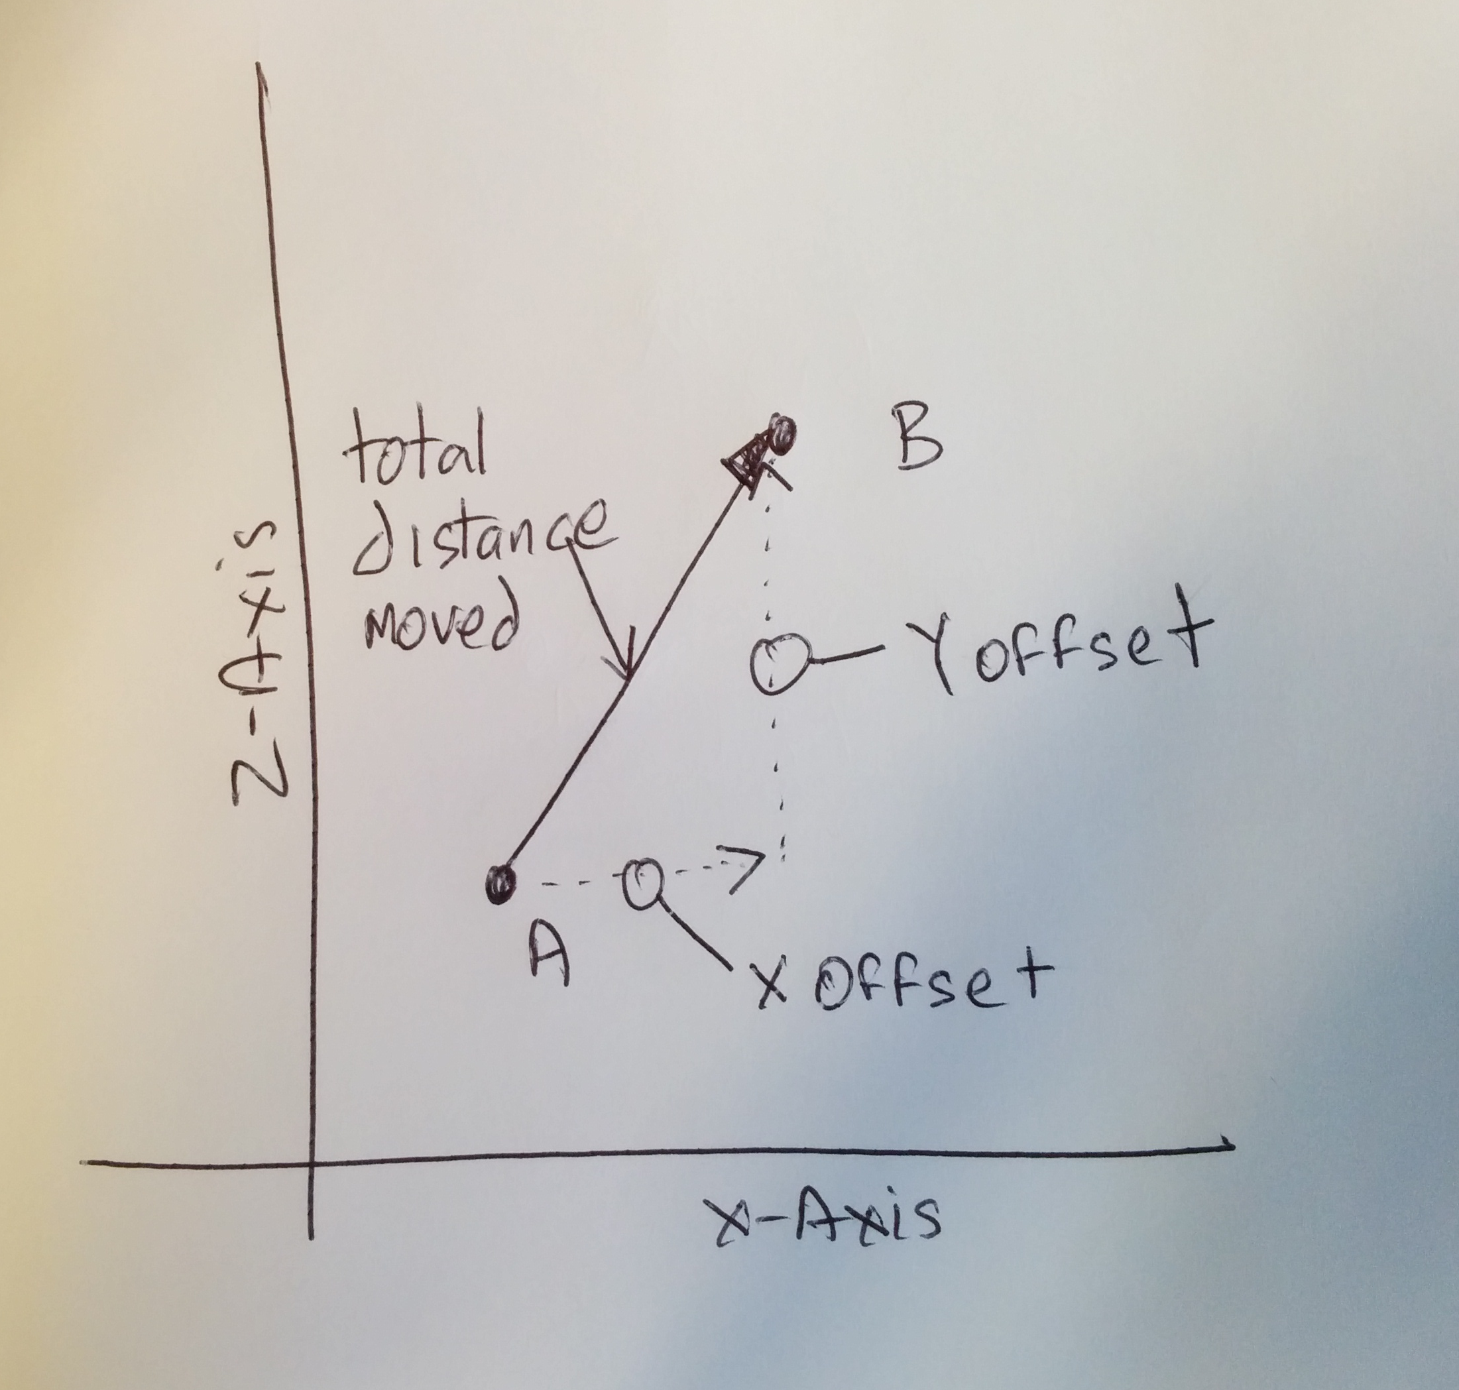

Slide 24
Unity Vectors
Sometimes we know the magntude/distance and we want to get the vector we add to the position
Without the direction vector the destination could be anywhere!
So we need a direction vector which is of length 1
We can then multiply the direction vector by the magnitude to get the offset vector
This will tell us how far we will travel and where we will end up
Example:
Speed is a scalar
It is the magnitude of the velocity vector
Velocity = speed * direction
In unity we rarely need to access the elements of the vectors
Instead we can add subtract and multiply in other scalars/vectors

Slide 25
Adding & Subtracting Vectors
Commutative Law for Addition:
A + B = B + A
Associative Law for Addition:
A + (B + C) = (A + B) + C
Commutative Law for Multiplication:
mA = Am
Associative Law for Multiplication:
(m + n)A = mA + nA, where m and n are two different scalars.
Distributive Law:
m(A + B) = mA + mB

Slide 26
Magnitude of a Vector
The magnitude of a vector V = (v₁,v₂,v₃)^{T} is given by:
|V| = sqrt(v₁*v₁ + v₂*v₂ + v₃*v₃)
eg (1,2,3)^{T} has magnitude sqrt(14)
Use:
.magnitude
To calculate the length (magnitude) of a vector
Notes:
21
21

Slide 27
Normalising a vector
To make the length 1 (a unit vector)
A unit vector in the direction of V is
^ V / |V|
Divide each component by the length
Or use:
v2 = v1.normalized
v1 DOES NOT get changed by the operation
OR v1.Normalize() – Normalizes v1

Slide 28
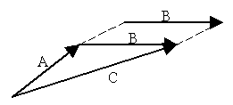
Vector addition
To add vectors, add the components
Both vectors must be of the same dimension
u + v = (u_{x} + v_{x}, u_{y} + v_{y}, u_{z} + v_{z})
Use the overloaded + operator

Slide 29
Vector Subtraction
To subtract 2 vectors, add the components
Both vectors must be of the same dimension
u - v = (u_{x} - v_{x}, u_{y} - v_{y}, u_{z} - v_{z})
Use the overloaded - operator

Slide 30
Scalar Multiplication
Multiply each component by a scalar
“Scales” the vector
Use the overloaded * operator

Slide 31
“Dot” product
“Multiply” 2 vectors together
u.v = (u_{x} v_{x} + u_{y} v_{y} + u_{z} v_{z})
u.v = |u||v|cos θ
Or cos θ = u.v / |u||v|
I.e. The cosine of the angle between them scaled by the vectors magnitude
For unit vectors, u.v = cos θ!
THIS IS INCREDIBLY USEFUL PROPERTY!

Slide 32
Interesting properties
If u.v = 0, then u v - Cos (PI/2) = 0
If u.v > 0, then θ > PI/2
If u.v < 0, then θ > PI/2
Use glm::pi<float>() to get PI
Use
float glm::dot(a, b)
To calculate

Slide 33
Dot product uses:
Dot product will be positive if an entity is in front of the entity
Orientation Vector
+
-

Slide 34
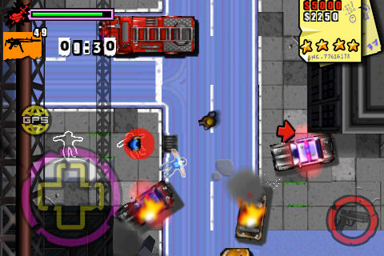
Consider…
Entity B
Entity A

Slide 35
Also…
Use the dot product to calculate angle of offset to opponent,
If angle > (FOV/2), then the opponent is inside the FOV!
Field of view
+
-

Slide 36
Cross product
Evaluates to another vector that is mutually perpendicular to the two vectors
p = u x v = (u_{y} v_{z} - u_{z} v_{y}, u_{z} v_{x} - u_{x} v_{z,} u_{x} v_{y} - u_{y} v_{x})
In code:
c = Vector3.Cross(a, b)
Axis of rotation
We can use this to find “normals” of planes/triangles
http://www.physics.uoguelph.ca/tutorials/vectors/vectors.html

Slide 37
Newtonian Physics
Time
Scalar measured in seconds (s)
Distance
Scalar measured in Meters (m)
Mass
A measure of the amount of something
Scalar measured in Kg
It is calculated as the force of gravity acting on an object
Unit of matter
Position
A vector (so you have an origin)
Its position relative to the origin
The position of an entities centre of mass
Balance point
The average location of all its mass

Slide 38
Newtonian Physics background
Velocity
A vector (has magnitude and direction) in m/s
Magnitude is the speed
v = Δx / Δt
Δx = Change in distance
Δt = Change in time

Slide 39
Examples
To calculate velocity:
If a ball travels 5 meters in 2 seconds, its velocity is:
v = 5/2 = 2.5 m/s
To calculate displacement:
Rearrange equation:
Δx = v Δt
To calculate positions:
If an object starts at 5 and is travelling at 10 m/s, after 3.5 seconds
P[t+1] = P[t] + vΔt
P[t+1] = 5 + (10 * 3.5) = 40

Slide 40
Acceleration
Vector quantity representing the rate of change in velocity over time
m/s/s or m/s²
a = Δv / Δt
In other worlds change in velocity / the time interval in which the change took place

Slide 41
Example
If a car starts from rest and accelerates at 2 m/s^{2,} then every 2 seconds, 2 m/s is added to the velocity
Time | Velocity
0 | 0
1 | 2
2 | 4
3 | 6

Slide 42
Relationship between velocity, time and acceleration

Slide 43
Relationship between velocity, acceleration and time
The equation y = mx + c can be used to calculate points on a line, where m is the gradient and c is the intercept
As constant acceleration is a straight line, y axis is velocity, x axis is time
v = at + u
v = velocity
a = acceleration
t = time
u = velocity at time t = 0

Slide 44
Example
Determine the velocity of a car starting with a velocity of 3 m/s and accelerating at 2 m/s² for 3 seconds
v = 2 * 3 + 3 = 9 m/s

Slide 45
Distance
Distance is = the area under the graph.
E.g.
In graph 1, Distance = velocity * time

Slide 46
Distance
Area A = Δt * u
Area B = .5 * (v-u) Δt
Therefore Δx = u Δt + .5(v-u) Δt
We know v-u = Δv and
Δv = a Δt
So we can use:
Δx = u Δt + .5 a Δt²
t
v-u
B
A
u

Slide 47
Force
Force is that quality that can alter an objects speed or direction
Force is nothing to do with motion
Force is only required to affect a change
For example no force is required to keep an arrow flying, only to start it off
Many forces can act on an object at the same time. If the sum of those forces is 0, the object will not change velocity

Slide 48
Friction
Gravity
Force
from
the table
Gravity
Force
from
wind
Buoyancy
Gravity
Friction

Slide 49
Problem!
If an item is dropped from the top of the empire state building, what will its velocity be by the time it reaches the ground, given that the height of the building is 381m
Acceleration due to gravity is 9.8M/s/s

Slide 50
Calculating acceleration
a = F/m or F = ma
a = acceleration
F = Force
m = mass
Example:
If the boat in the diagram has a mass of 2000kg and is accelerating at 1.5m/s²
The force acting on the boat is:
2000 * 1.5 = 3000N

Slide 51
Also!
If we know:
Force, position mass and time
We can calculate the acceleration and update the position and velocity

Slide 52
In summary
F = Ma
a = Δv/Δt
v = Δx/Δt
Δx = v Δt
Δx = u Δt + .5 a Δt²
For all the of thefollowing example, check out the vectors branch of the Unity repo!

Slide 53
Example 1: Moving to a destination point
Vector3 dest = new Vector3(20, 5, 20);
Vector3 toDest = dest - transform.position;
if (toDest.magnitude > 0.1f)
{
toDest.Normalize();
float speed = 5.0f;
transform.position += toDest * speed * Time.deltaTime;
transform.forward = toDest;
}

Slide 54
Example 2: Integration
Vector3 acceleration = force / mass;
velocity += acceleration * Time.deltaTime;
gameObject.transform.position += velocity * Time.deltaTime;
force = Vector3.zero;
if (velocity.magnitude > 0.01f)
{
gameObject.transform.forward = Vector3.Normalize(velocity);
}
velocity *= 0.99f;

Slide 55
Example 3: Range
Vector3 toOtherShip = otherShip.transform.position - gameObject.transform.position;
string message;
if (toOtherShip.magnitude > 10.0f)
{
message = "Out of range";
}
else
{
message = "In range";
}

Slide 56
Example 4: In front of/behind
Vector3 toOtherShip = otherShip.transform.position - gameObject.transform.position;
toOtherShip.Normalize();
float dot = Vector3.Dot(toOtherShip, transform.forward);
if (dot < 0)
{
GameManager.PrintMessage("Behind");
}
else
{
GameManager.PrintMessage("In front");
}

Slide 57
Example 5: FOV
float dot = Vector3.Dot(toOtherShip, transform.forward);
float fov = Mathf.Deg2Rad * (45.0f / 2.0f);
float angle = Mathf.Acos(dot);
if (angle < fov)
{
GameManager.PrintMessage("Inside FOV");
}
else
{
GameManager.PrintMessage("Outside FOV");
}

